Slide 1
HOUSING PROJECT
SUBMITTED BY:-
RISHABH JOHRI
DATA SCIENCE- INTERN AT FLIP ROBO TECHNOLOGIES

Slide 2
Business Problem Framing:-
Houses are one of the necessary needs of each and every person around the globe and therefore housing and real estate market is one of the markets which is one of the major contributors in the world’s economy. It is a very large market and there are various companies working in this domain. Data science comes as a very important tool to solve problems in the domain to help the companies increase their overall revenue, profits, improving their marketing strategies and focusing on changing trends in housing sales and purchases. Predictive modelling, Market mix modelling, recommendation systems are some of the machine learning techniques used for achieving the business goals for housing companies. Our problem is related to one such housing company.
House price prediction can help the developer determine the selling price of a house and can help the customer to arrange the right time to purchase a house. House Price prediction, is important to drive real estate efficiency. As earlier, House prices were determined by calculating the acquiring and selling price in a locality. Therefore, the House Price prediction model is very essential in filling the information gap and improve Real Estate efficiency. The aim is to predict the efficient house pricing for real estate customers with respect to their budgets and priorities. By analysing previous market trends and price ranges, and also upcoming developments the future prices will be predicted as per cost of property depending on number of attributes considered.

Slide 3
Why is House Price Prediction important?
House Price prediction, is important to drive Real Estate efficiency. As earlier, House prices were determined by calculating the acquiring and selling price in a locality. Therefore, the House Price prediction model is very essential in filling the information gap and improving the Real Estate efficiency.
There are three factors that influence the price of a house which includes:-Physical conditions, concept and the Location. Hence it becomes one of the prime fields to apply the concepts of machine learning to optimize and predict the prices with high accuracy. Therefore, in this project report we present various important features to use while predicting housing prices with good accuracy. While using features in a regression model, some feature engineering is required for more better prediction.

Slide 4
MAIN AIM FOR THIS PROJECT:-
The primary aim of this report is to use these Machine Learning Techniques and convert them into Machine Learning models which can then serve the users. The main objective of a Buyer is to search for their dream house which has all the amenities they need. Furthermore, they look for these houses/Real estates with a price in mind and there is no guarantee that they will get the product for a deserving price and not overpriced. Similarly, A seller looks for a certain number that they can put on the estate as a price tag and this cannot be just a wild guess, lots of research needs to be put to conclude a valuation of a house.

Slide 5
Data Pre Processing and EDA Steps :-
As a first step I have imported all required libraries and I have imported both the datasets which were in csv format.
Then I did all the statistical analysis like checking shape, n unique- for unique values, value counts, info etc.
While checking the info of the datasets I found some columns with more than 80% null values, so these columns will create skewness in datasets so I decided to drop those columns.
Then while looking into the value counts I found some columns with more than 85% zero values this also creates skewness in the model and there are chances of getting model bias so I have dropped those columns with more than 85% zero values.
While checking for null values I found null values in most of the columns and I have used imputation method to replace those null values (mode for categorical column and mean for numerical columns).
In Id and Utilities column the unique counts were 1168 and 1 respectively, which means all the entries in Id column are unique and ID is the identity number given for particular asset and all the entries in Utilities column were same so these two column will not help us in model building. So , it is decided to drop those columns.
Next as a part of feature extraction I converted all the year columns to there respective age. Thinking that age will help us more than year.
And all these steps were performed to both train and test datasets separately.

Slide 6
SOME EDA STEPS WHICH HAS BEEN PERFORMED :- 1. For checking the rows and columns present in the dataset Data.shape 2. For Checking the null values in the dataset:- Command used:- data.isnull().sum() 3. For checking the statistical summary of dataset: Command used:- data,describe() 4. For checking the available columns in the dataset: Command used:- data.columns
5. FOR CHECKING THE DATATYPE OF EACH FEATURES:-
COMMAND USED:- DATA.DTYPES
6. FOR OBSERVING THE INFORMATION ABOUT DATASET:-
COMMAND USED:- DATA.INFO()

Slide 7
Data Inputs , Logic and Output Relations:- 1. I have used box plot for each pair of categorical features that shows the relation with the median sale price for all the sub categories in each categorical feature. 2. And also for continuous numerical variables I have used reg plot to show the relationship between continuous numerical variable and target variable. 3. I found that there is a linear relationship between continuous numerical variable and Sale Price. Hardware and Software Requirements and Tools Used:- While taking up the project we should be familiar with the Hardware and software required for the successful completion of the project. Here we need the following hardware and software. Hardware used:- - 1. Processor — core i5 2. RAM — 8 GB 3. HDD — 1TB. Software Required:- 1. Anaconda. Libraries Used:- Import numpy as np Import pandas as pd Import seaborn as sns Import matplotlib.pyplot as plt Import warnings warnings.filterwarnings(“ignore”)

Slide 8
Testing of Identified Algorithms:-
Here, Sale Price was my target and it is a continuous column so this problem is regression problem. And I have used all regression algorithms to build my model. By looking into the difference of r2 score and cross validation score I found Gradient Boosting Regressor as a best model with least difference between Cv and R2 Score, Also to get the best model we have to run through multiple models and to avoid the confusion of overfitting we have go through cross validation. Below are the list of regression algorithms I have used in my project:-
GradientBoostingRegressor.
RandomForestRegressor.
KNeighborsRegressor .
DecisionTreeRegressor.
ExtraTreesRegressor.

Slide 9
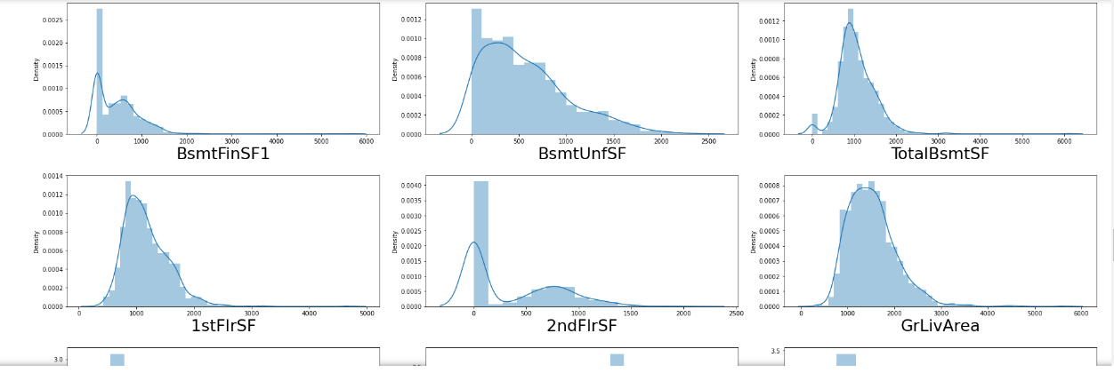
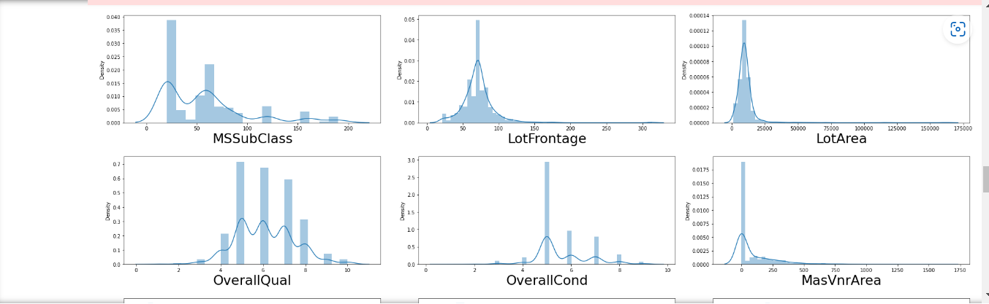
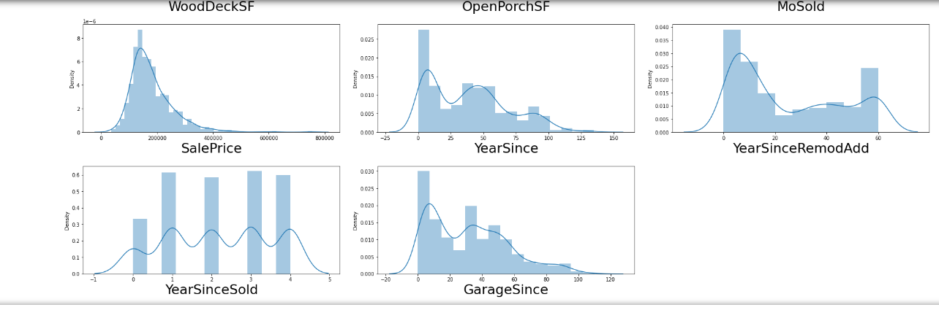
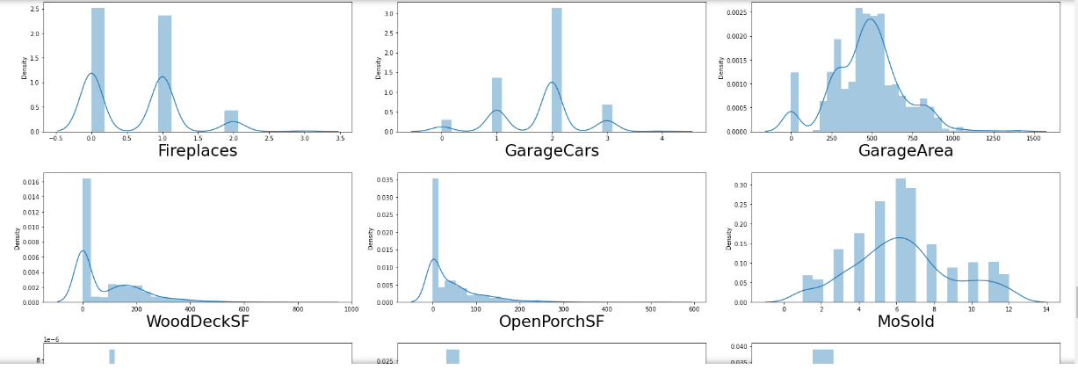
VISUALISATIONS:-
Visualisation of Numerical data using Dist plot method:-

Slide 10
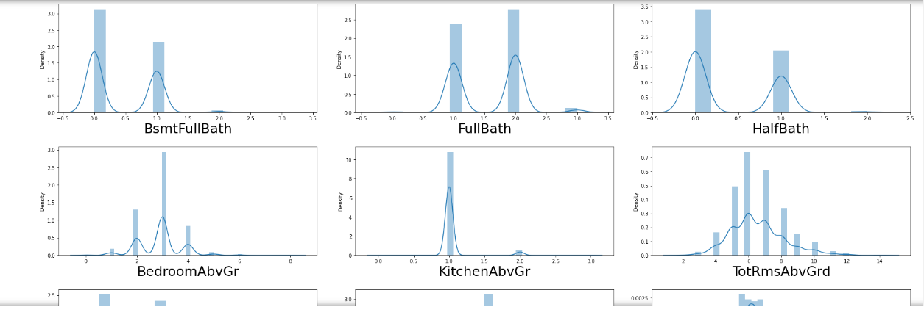

Slide 11
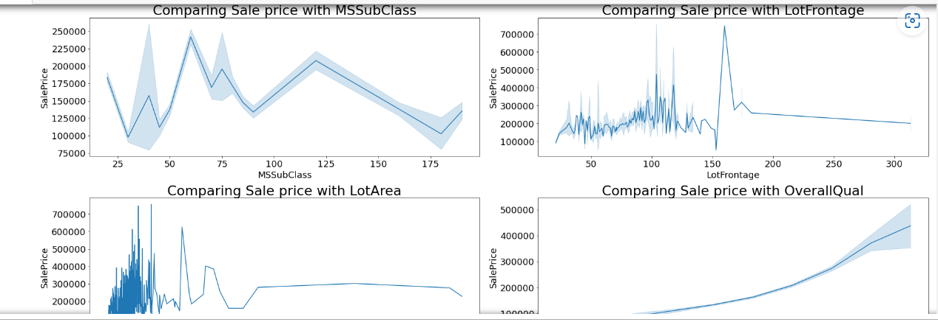
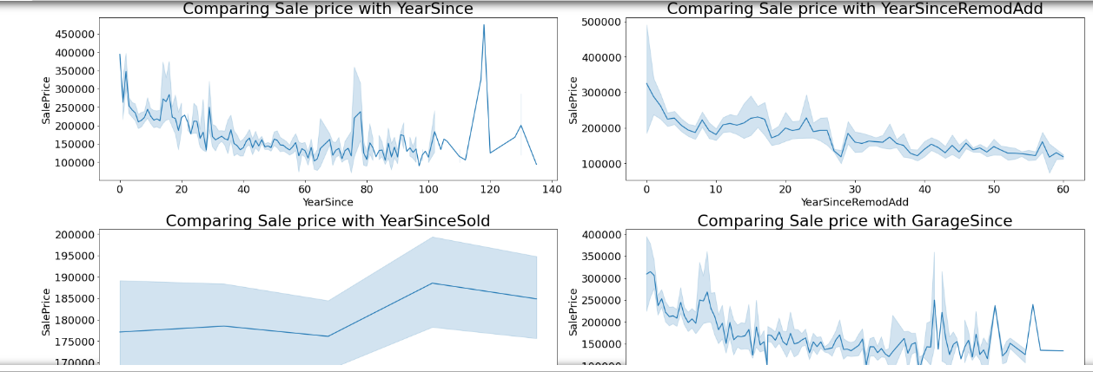
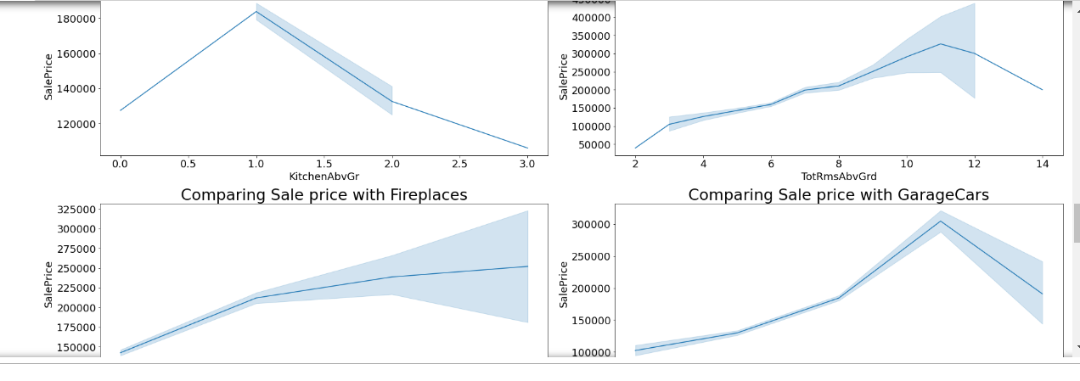
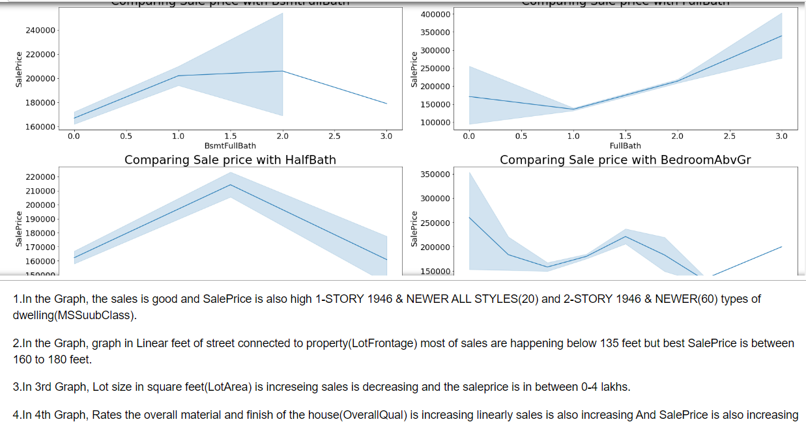
COMPARING NUMERICAL DATA WITH TARGET COLUMN:-

Slide 12
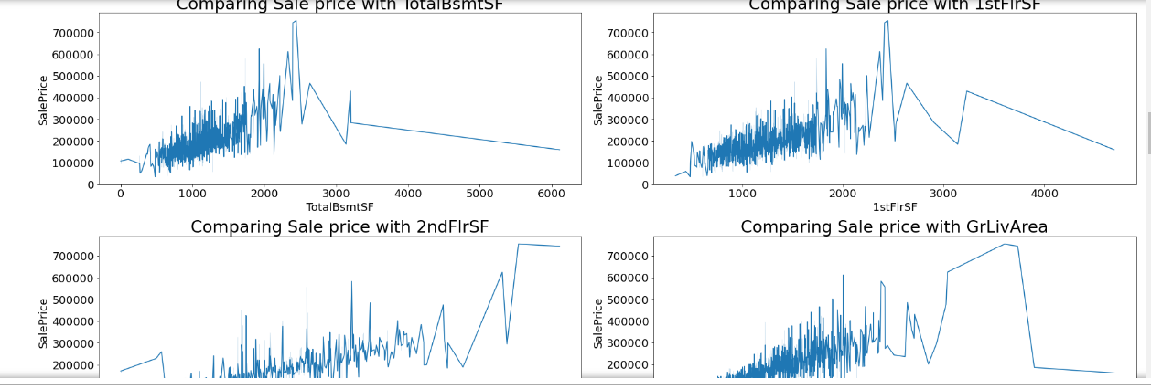
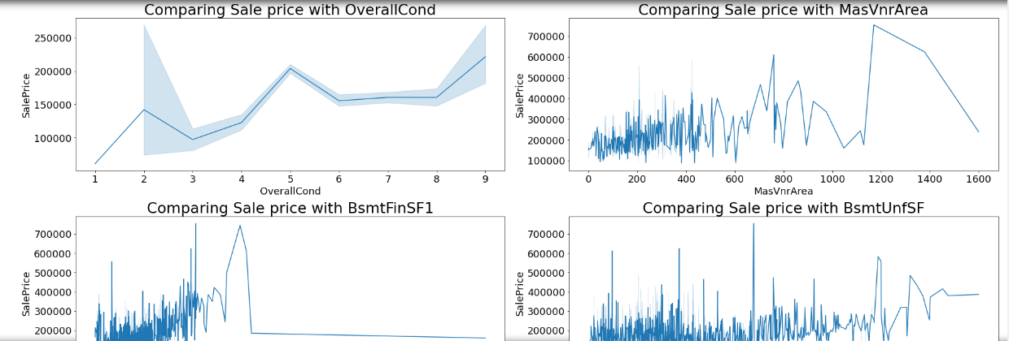

Slide 13
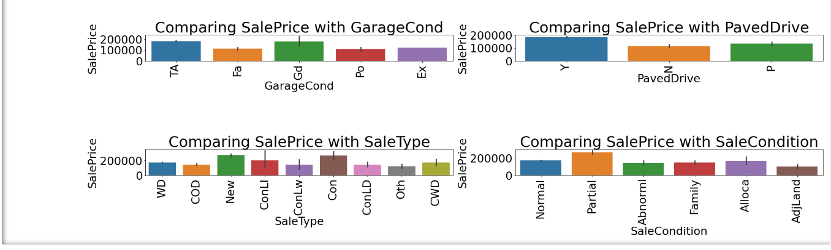
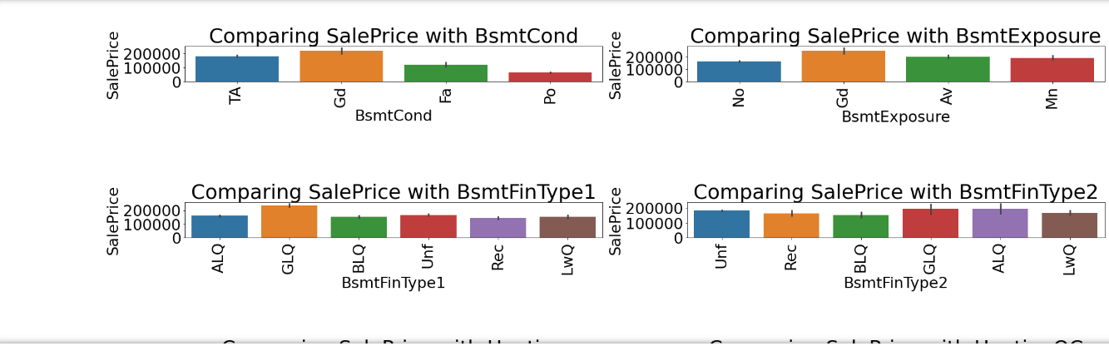
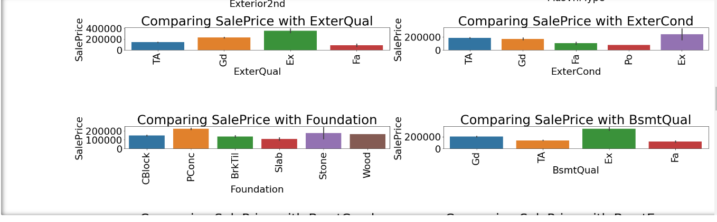
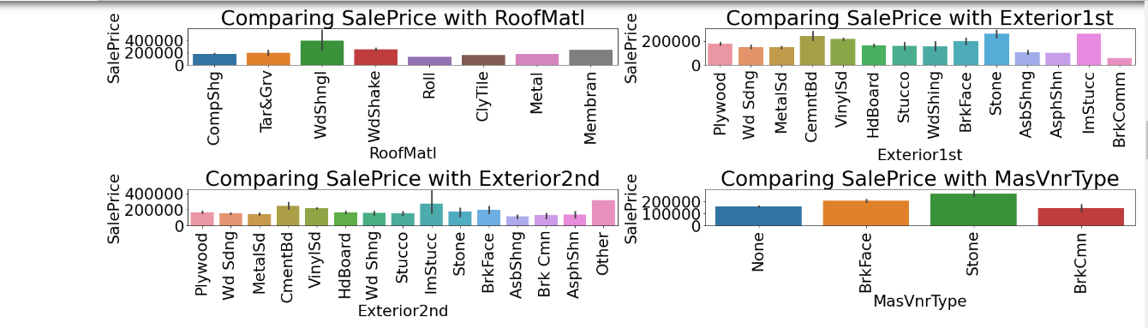
Visualisation of Categorical Features with Target Columns:-

Slide 14
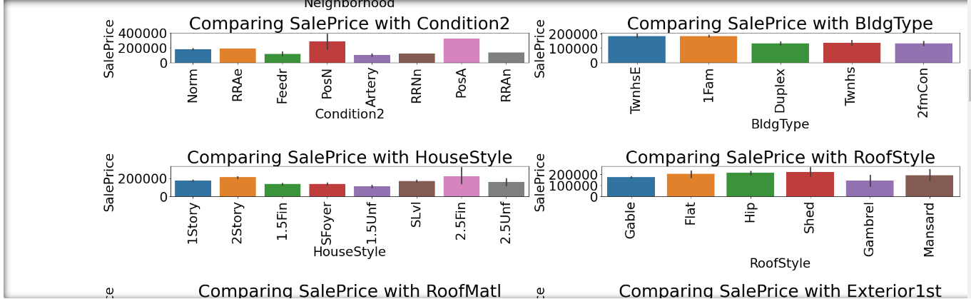
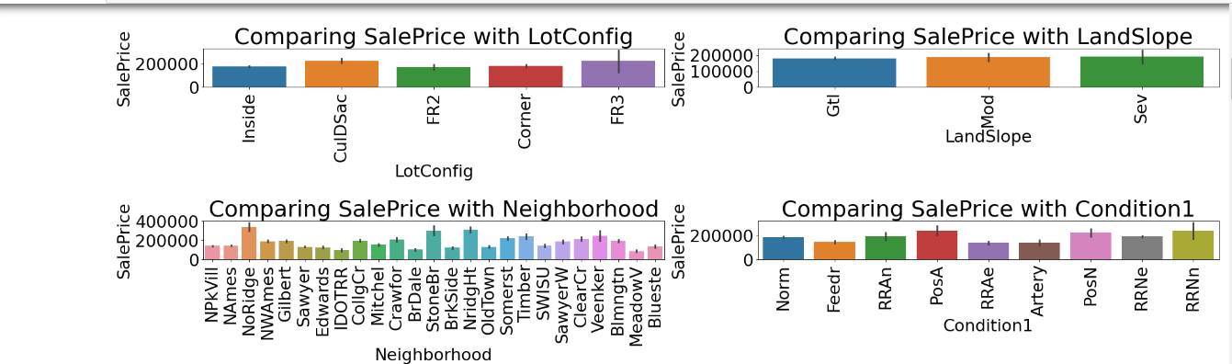
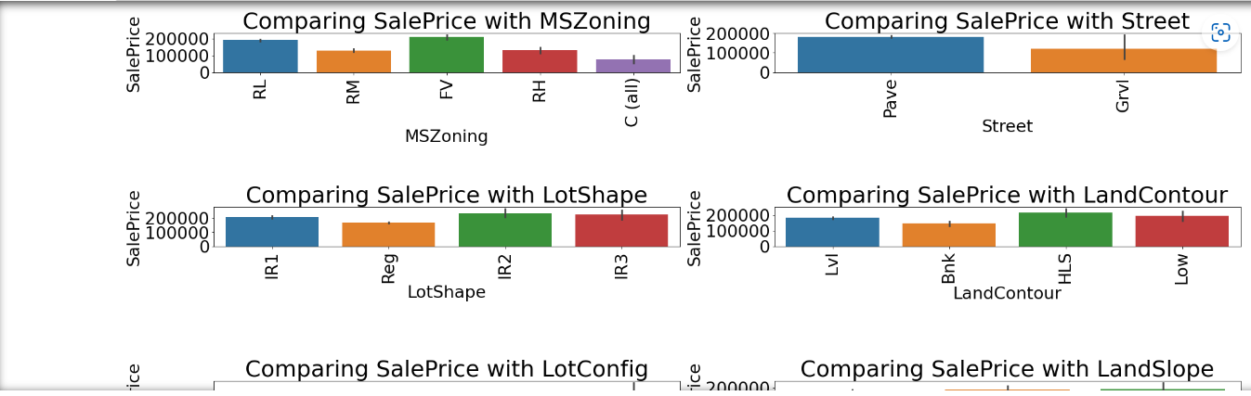

Slide 15
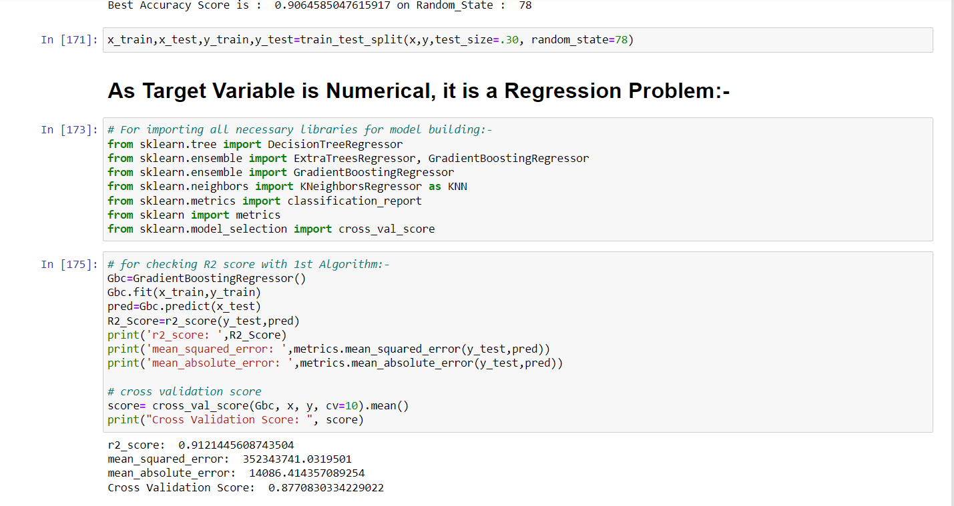
MODEL BUILDING PHASE AND SELECTING BEST MODEL OUT OF BELOW TESTED MODELS:-

Slide 16
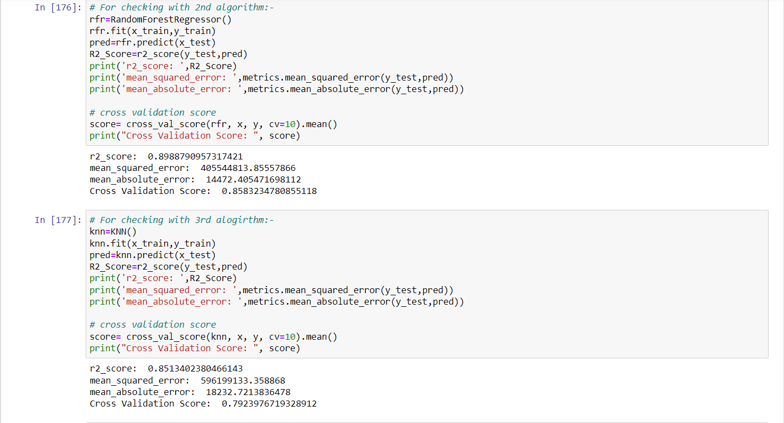

Slide 17
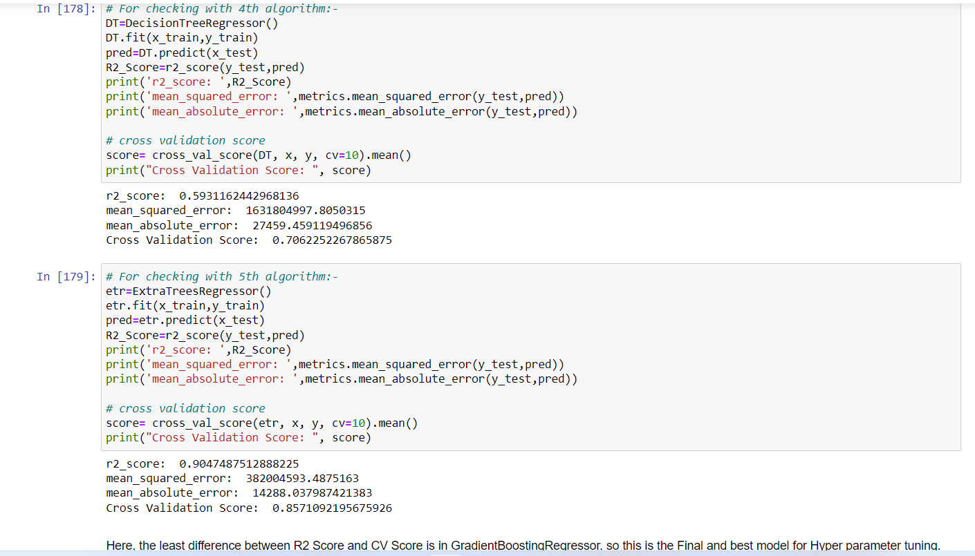

Slide 18
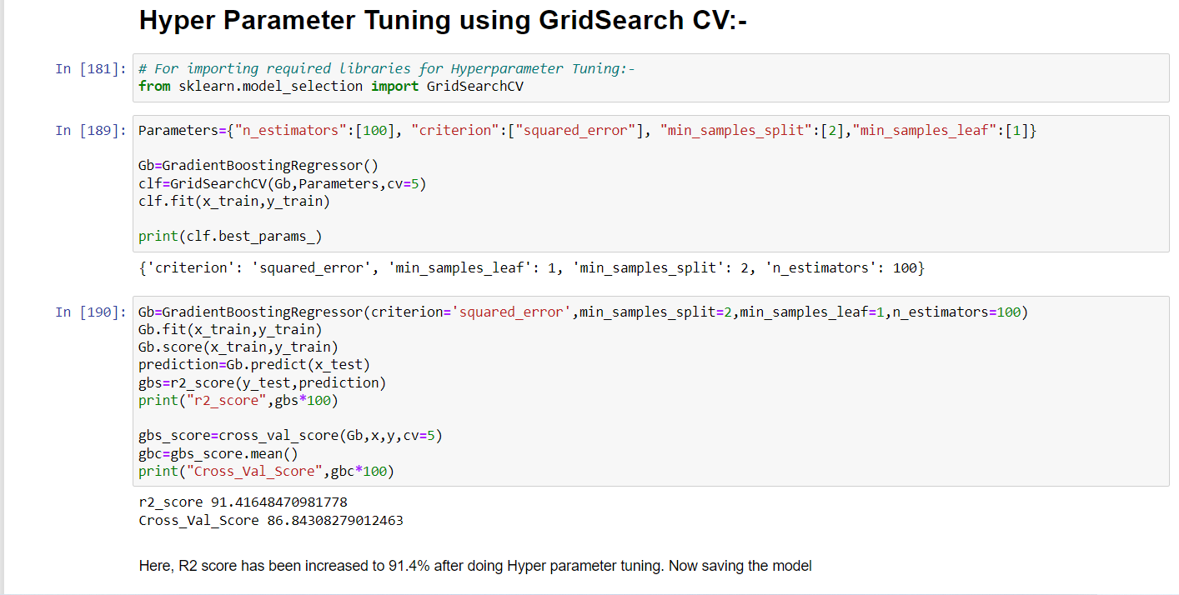
HYPER PARAMETER TUNING USING GRID SEARCH CV:-

Slide 19
SO , THE BEST AND FINALISED MODEL IS GRADIENT BOOSTING REGRESSOR WITH R2 SCORE OF 91.4 % AFTER HYPER PARAMETER TUNING AND WITH LEAST DIFFERENCE BETWEEN CROSS VALIDATION SCORE AND R2 SCORE .

Slide 20
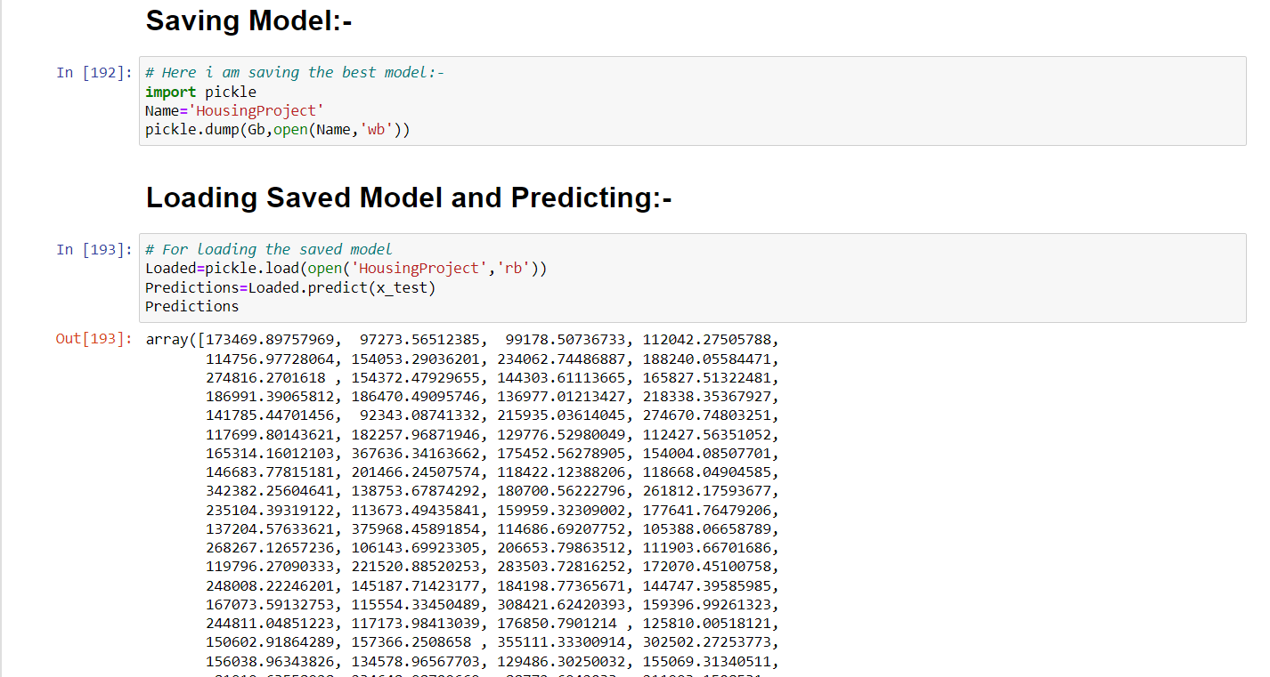
SAVING AND LOADING MODEL:-

Slide 21
Interpretation of the Results:-
Here, the datasets were having null values and zero entries in maximum columns so we have to be careful while going through the statistical analysis of the datasets and proper plotting for proper type of features will help us to get better insights on the data. I found maximum numerical continuous columns were in linear relationship with target column.
I notice a huge amount of outliers and skewness in the data so we have chosen proper analytical methods to deal with the outliers and skewness. If this outliers and skewness are ignored, we might have lose our model accuracy which would have predicted wrong/ less accuracy.
Then we performed scaling on both train and test dataset so that our model don’t get biased.
We used multiple models while building model using train dataset to get the best model out of it.
Then we used multiple metrics like MAE, MSE and R2_score which will help us to decide the best model
I found Gradient Boosting Regressor as the best model with 91.2% R2_score. Also, we managed to improve the accuracy of the best model by running hyper parameter tuning to 91.4%.
At the end, I have predicted the Sale Price for test dataset using saved model of train dataset. I was able to get the predictions near to actual values.

Slide 22
Conclusion:-
In this project , we have used Machine Learning algorithms to predict the house prices. We have mentioned the step by step procedure to analyze the dataset and finding the correlation between the features. Here, we can select the features which are not correlated to each other and are independent in nature. These feature set were then given as an input to five algorithms and a csv file was generated consisting of predicted house prices. Hence we calculated the performance of each model using different performance metrics and compared them based on these metrics. Then the Data Frame is also saved for predicting Sale prices of test dataset.

